Slide 1

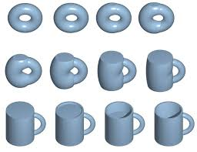
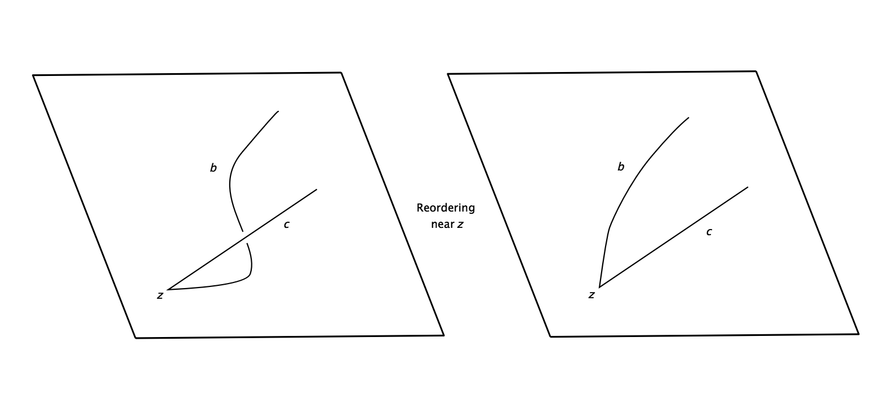
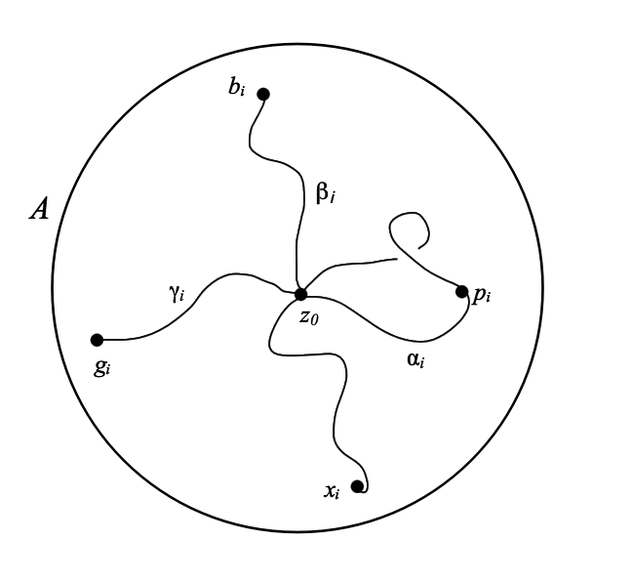
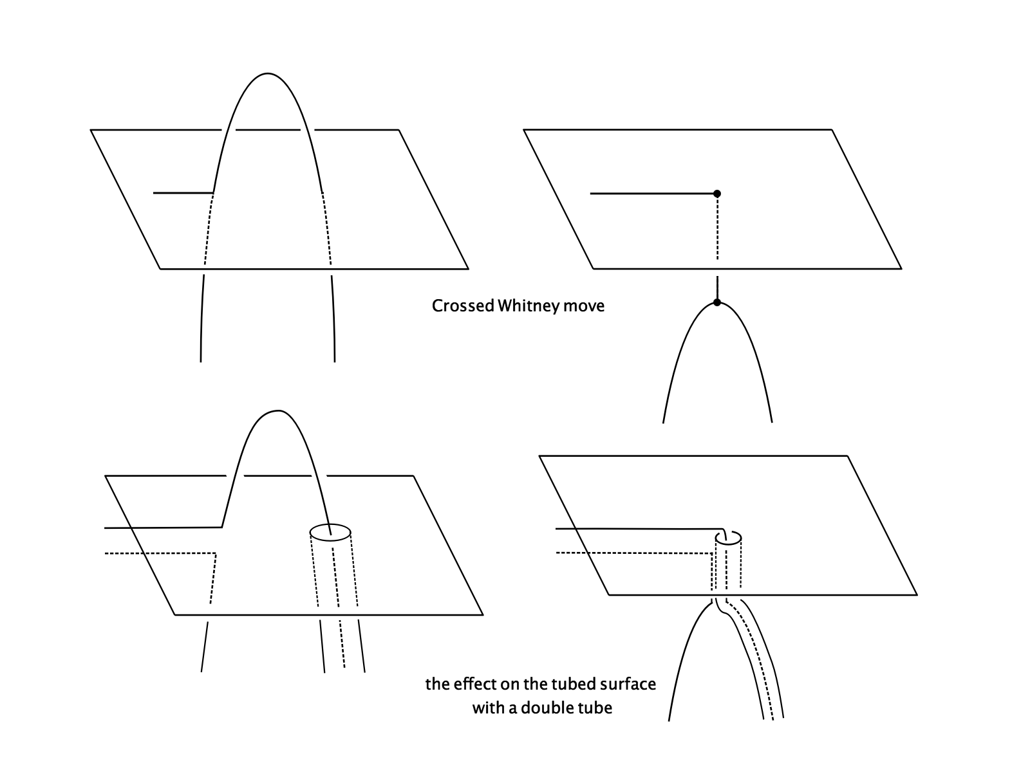
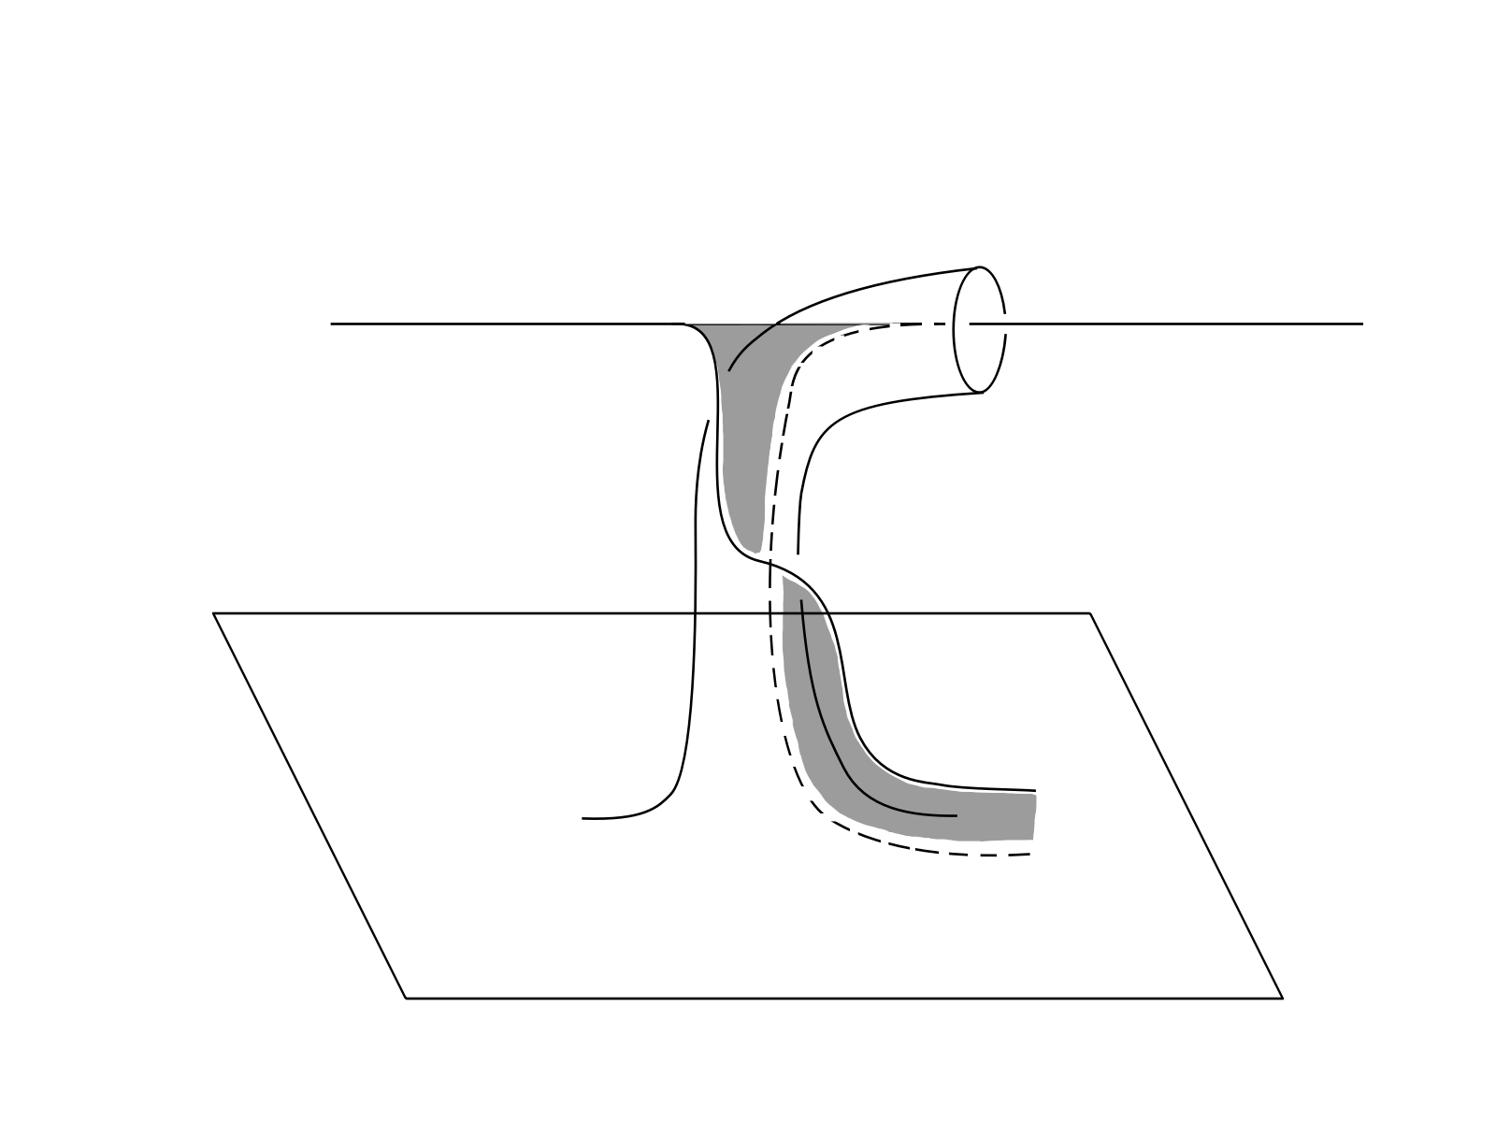
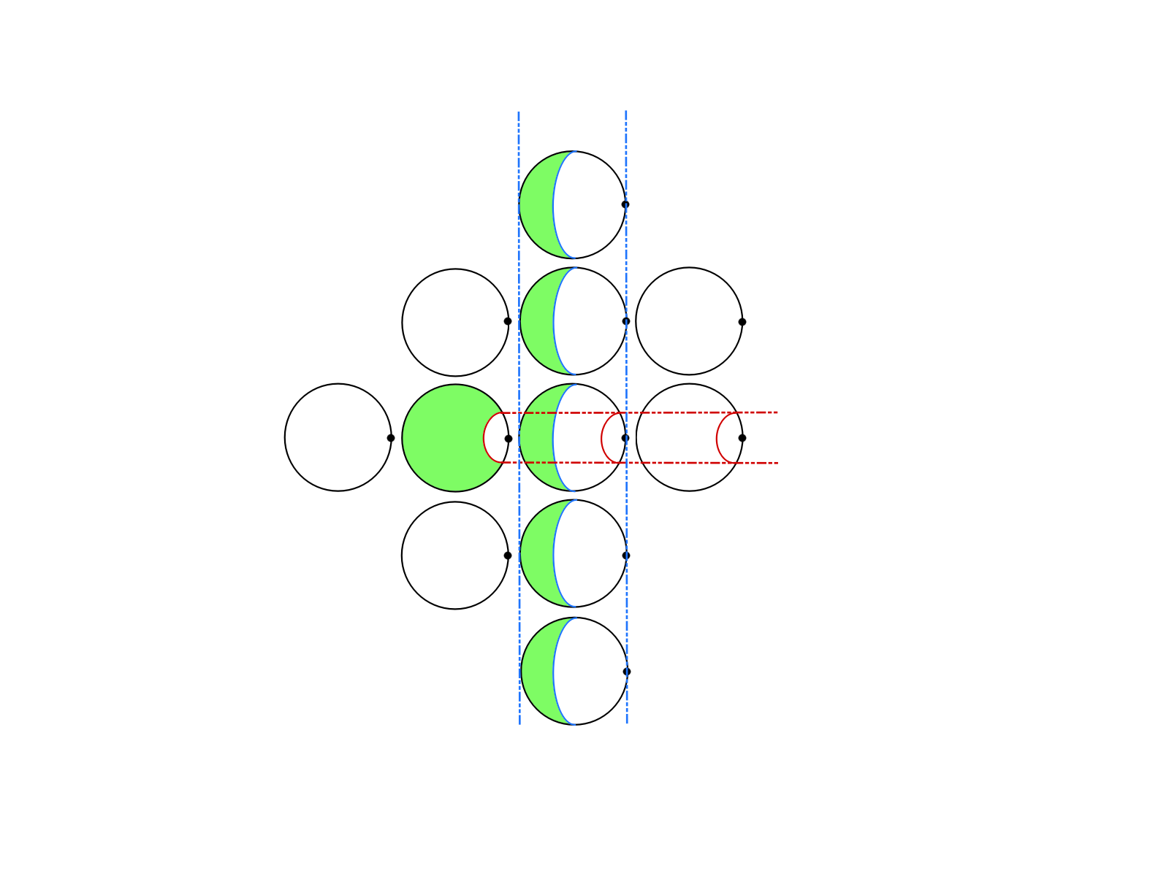
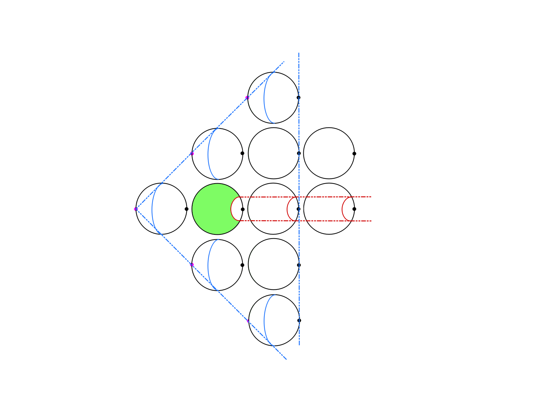
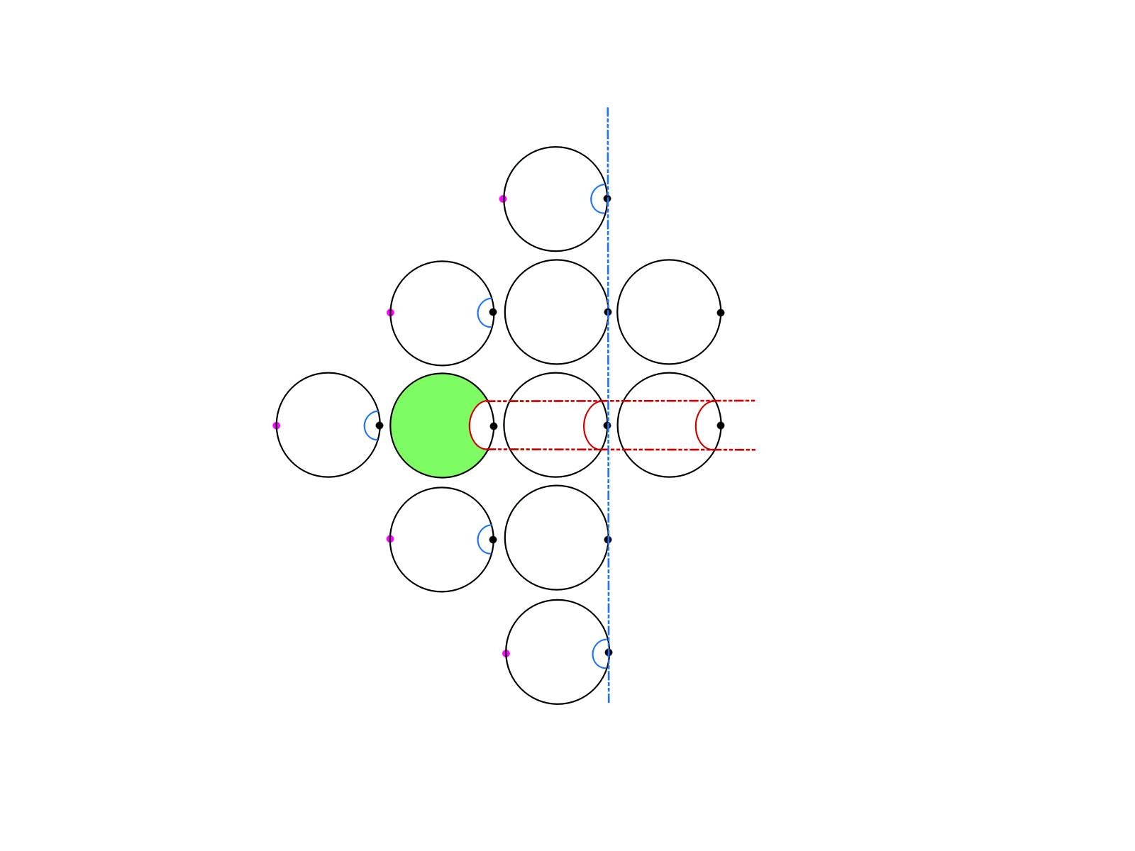
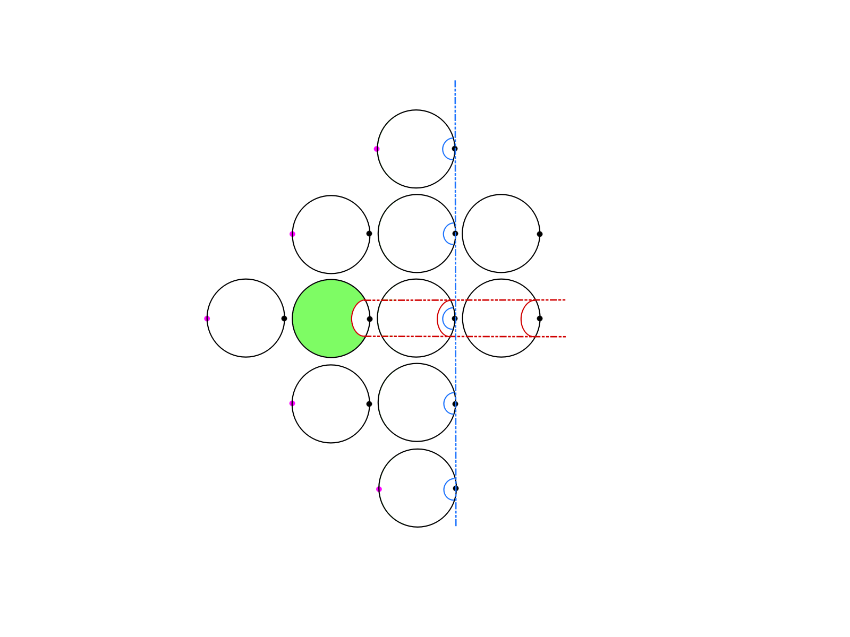
THE 4-DIMENSIONAL LIGHT BULB THEOREM
Elizabeth Gorton & Anna Jeffries with Dr. Nathan Sunukjian
Topology
David Gabai's Proof
Conclusions
"Topology" is the term used for the field of mathematics that looks at the geometrical relationships and properties of space. One way to think about this is if you have a big sheet of rubber that you can mess around with like Play-Doh. The classic illustration of topology is that, from a topological perspective, a doughnut and a coffee mug are the same thing.
Topology is not limited to only the 3rd dimension. In fact, the most interesting topology occurs in the 4th dimension, which is what the 4-dimensional light bulb theorem is about.
In 2017, David Gabai, a mathematician at Princeton University, released a proof of the 4-dimensional light bulb theorem which, until then, had been unproven. Gabai's paper has not been formally published to date, but our project was to dissect Gabai's proof and to condense his 40-page paper into a shortened overview of the key points in order to make the proof more accessible and understandable for others who may be interested in understanding the results.
Gabai begins his proof by utilising standard topological methods, such as Reidemeister moves and Whitney moves, in an underlying immersed surface. This underlying surface then becomes the 'blueprint' for another embedded surface. The paths and manipulations in the underlying surface translate to this new surface with tubes and other ways of pushing the surface around. Some paths create single tubes; other paths create double tubes that are linked together like a 4-dimensional Hopf link.
The reason why there's this rather complicated set-up is because the goal is to prove that the underlying immersed surface A is isotopic to itself, even after all kinds of moves and manipulations to the surface (think of the doughnut and the coffee mug). But it's easier to prove this by showing that the embedded surface B, with all of the tubes, is isotopic, and then, using the relationship between A and B, we can conclude that, just as B remains the same as the knotted tubes are untangled, A remains unchanged. Unknotting B requires a lot of careful work, but Gabai does successfully demonstrate that the light bulb theorem does, indeed, hold for 4-dimensional space.
While there are many branches to higher mathematics, David Gabai's proof of the 4-dimensional light bulb theorem is a significant result for modern topology and hence our motivation for reading the original proof and creating a shortened version.
We've fondly dubbed our paper "The 4-D Light Bulb Theorem for Busy People" and hope to make it available online in the near future so that fellow mathematicians can understand the key results without having to work through Gabai's lengthy and complex paper.
We'll also note here that Robert Edwards, a former professor at UCLA, has also written about David Gabai's proof in his paper "The 4-dimensional Light Bulb Theorem (After David Gabai)." Edwards expands on Gabai's ideas and provides another way of proving the theorem that we have also considered as part of this project.
While Gabai works in S² × S², this result can be applied to higher genus surfaces as well.
The Theorem
The easiest way to think about the light bulb theorem is to imagine that you have a lightbulb that is hanging from a knotted rope. The theorem states that you can unknot the rope without moving the lightbulb. This principle has been demonstrated for 3-dimensional space but has only been recently shown to be true for 4-dimensional space as well. The formal statement of the 4-dimensional light bulb follows below.
The 4-dimensional light bulb theorem:
If R is an embedded 2-sphere in S² × S², homologous to x₀ × S², that intersects S² × y₀ transversely and only at the point (x₀, y₀), then R is isotopic to x₀ × S² via an isotopy fixing S² × y₀ pointwise.
Examples of paths and manipulations in both A and B.
References
Gabai, David. "The 4-dimensional Light Bulb Theorem."
Edwards, Robert. "The 4-dimensional Light Bulb Theorem (After David Gabai)."
Acknowledgements
An example of a sequence of moves required to unknot B.
Many thanks to our faculty supervisor, Dr. Nathan Sunukjian, and to our donors who funded our research.
10848-5 calvingraphics@gmail.com

